Slide 1

Business Model – AI company AIKm Fred Wong, eFusion Capital

Slide 2
Who are we?
Technology boutique asset management firm
Specializing in global tech-hardware (e.g. semi-conductor) and tech-software (e.g. AI) sectors Asset management via discretionary managed account structure
Capital introduction services for technology start-ups; deal sourcing for VC, PE, and family offices
AI transformation management consulting, education
Established in 2014, with 11 years of history

Slide 3
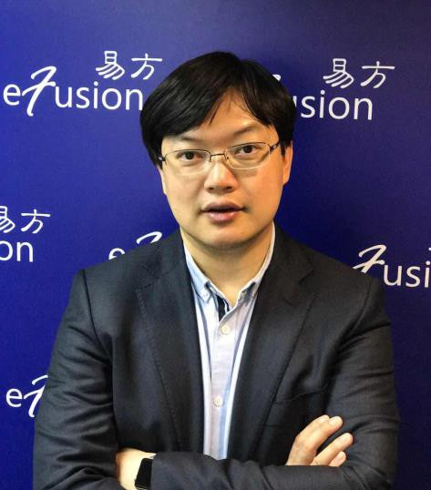






Fund Manager : Fred Wong, CFA
Industry experience:
10 years of semiconductor industry (e.g. UMC/ Novatek/ Realtek) management experience
B.Eng, HKU
Finance:
20 years of equity research/fund management experience
2009 Thomson Reuters Starmine IT industry #1 Analyst

Slide 4
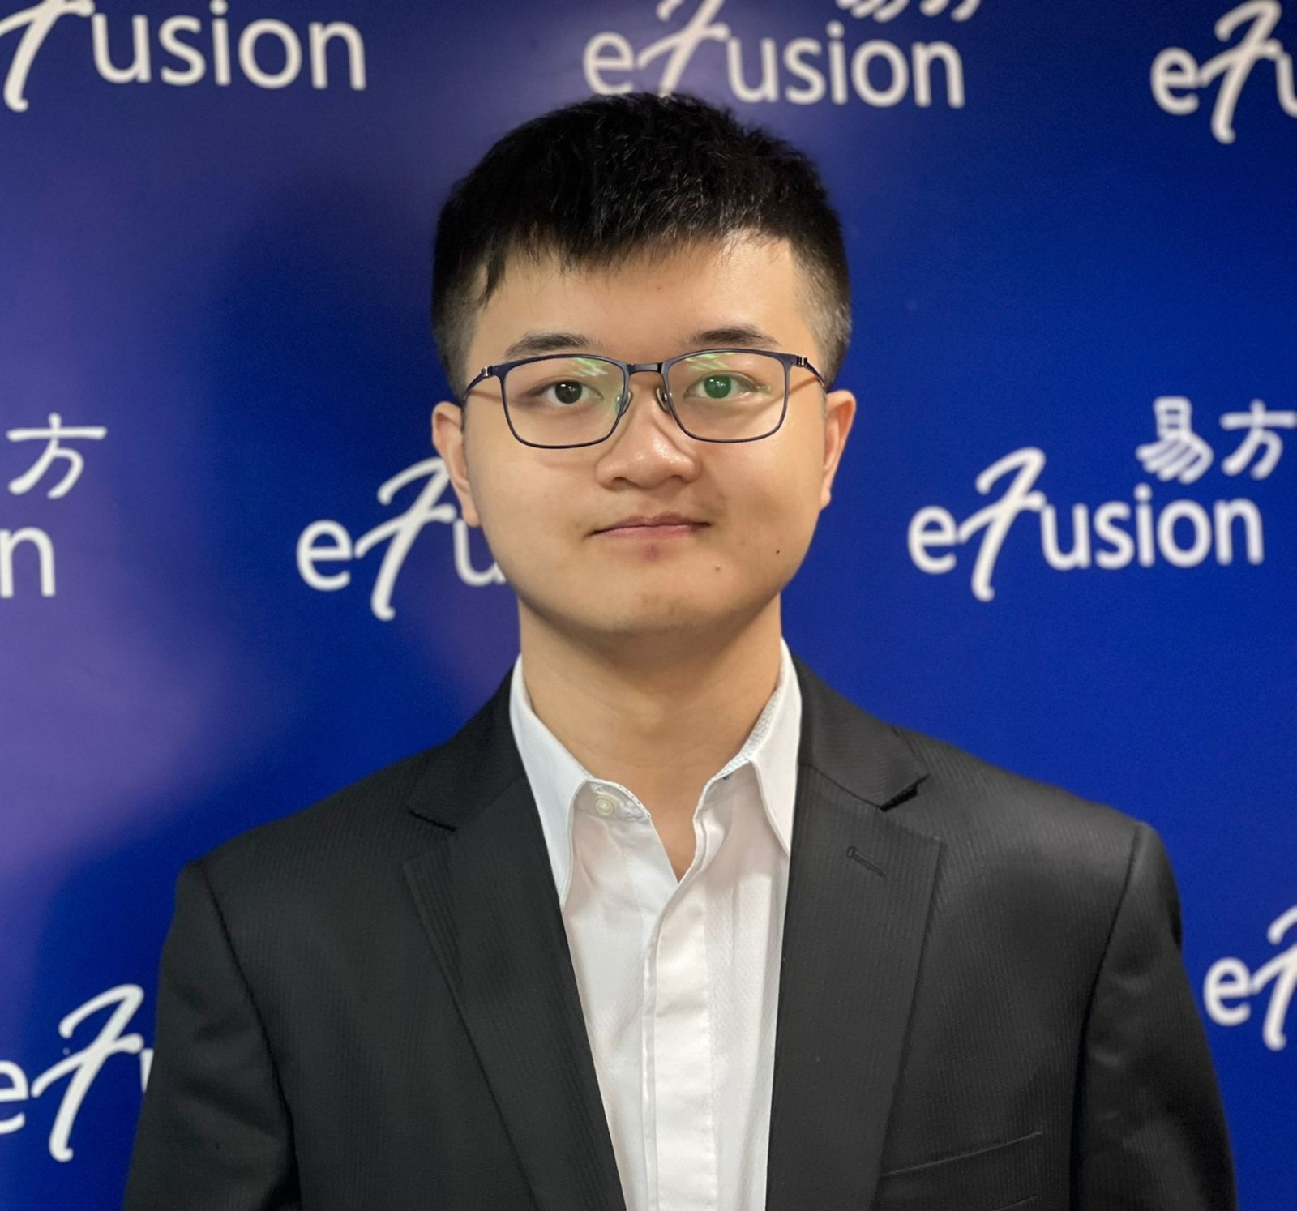


Portfolio manager: Isaac Wong
Federation of Hong Kong Industries ExCo International Association of Chinese Traders Exco Bachelor of Finance, HKU Responsible for managing discretionary accounts 5 years of research/portfolio management experience

Slide 5
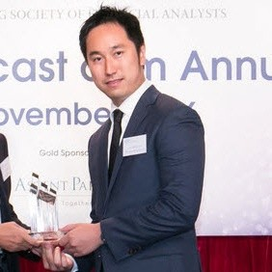




Head of Capital Intro: Robin Yuen, CFA
Leads capital introduction services for tech corporates 10+ years of equity research experience from CLSA, Barclays, UOB, RHB
Sector expertise in consumer, industrials, TMT
Bachelor of Science (Finance and Economics), NYU Stern

Slide 6
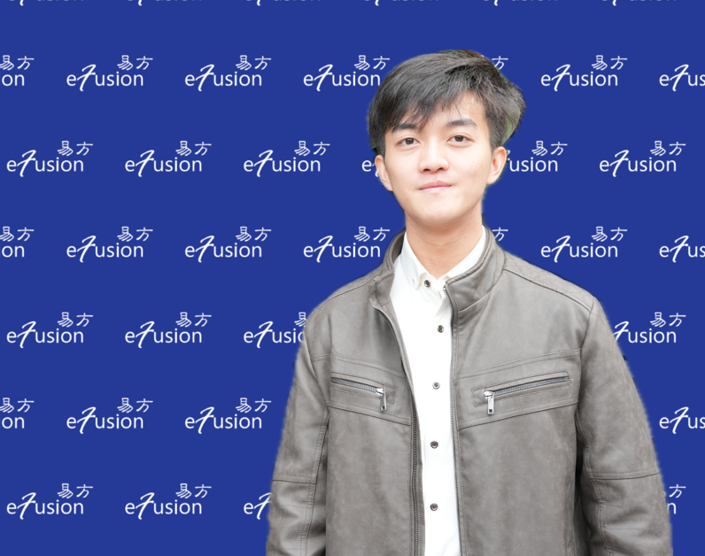
AI Researcher: Owen Wong
Lecturer of Artificial Intelligence course for Kaplan, private banks, institutional corporations
Entrepreneur in AI-powered start-up companies with funding from HK Science Park (HKSTP) and QianHai region.
HKET Columnist, guest speaker on RTHK/FUTU/WeBull, etc.
Responsible for AI Researches and building AI algorithms. Bachelor of Arts and Sciences in Applied Artificial Intelligence, HKU

Slide 7




COO – Cindy Chu, CFA
Professional background:
15 years of equity research experience, serving at Merrill Lynch/FIL/Citigroup/JP Morgan/Morgan Stanley JP Morgan semiconductor industry analyst ( II ranking #1 team) from 2002-2005
Academic background:
CFA, MBA HKUST, M Social Science HKU BEng (Computer Engineering), CUHK

Slide 8
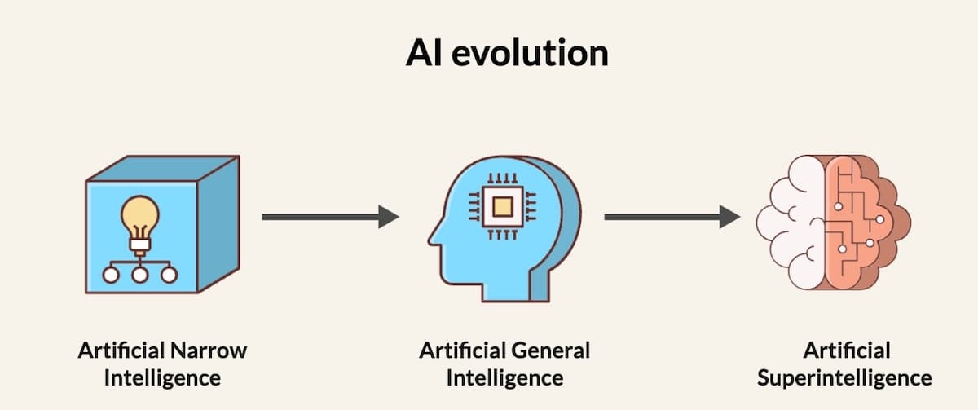
Wisdom from analyzing wisdom direclty

Slide 9
Business model…
How to become an interesting guy?

Slide 10
3 dimensions
ASIC
L Chip, Faraday, GUC
ASSP
Mediatek, Qualcomm, Cambricon, HiSilicon
GP
Intel, AMD, nVidia

Slide 11
3 dimensions
ASIC
Palantir, Accenture, Sensetime
ASSP
AutoCAD, Cadence, Synopsys
GP
SaaS Microsoft, Adobe, Oracle, SAP
PaaS IBM

Slide 12
3 dimensions
ASIC
L Chip, Faraday, GUC
Palantir, Accenture, Sensetime
ASSP
Mediatek, Qualcomm, Cambricon, HiSilicon
AutoCAD, Cadence, Synopsys
GP
Intel, AMD, nVidia
SaaS Microsoft, Adobe, Oracle, SAP
PaaS IBM

Slide 13
B or To C?
Semiconductor all toＢ

Slide 14
Dimension expansion
More-few dimensional
High-low dimension

Slide 15
What is creativity?
Degree of Freedom (DoF)
Dimensions switching, eyeballs reflecting
Convergence or Divergence (pupil dilate)
Turn several corners

Slide 16
Step by step?
Boundary VS Borderless
Think inwards VS outwards (enlarge)
0 to 1 vs 1 to 10000
Metaphor

Slide 17
Book recommendation
Look inwards, put down ego
Kant, Schopenhauer, Q
ABO – Training of generalization, from ASIC to GP

Slide 18
Outliner vs Inliner
Metronome VS Tuning Fork
Synchronization
Frequency

Slide 19
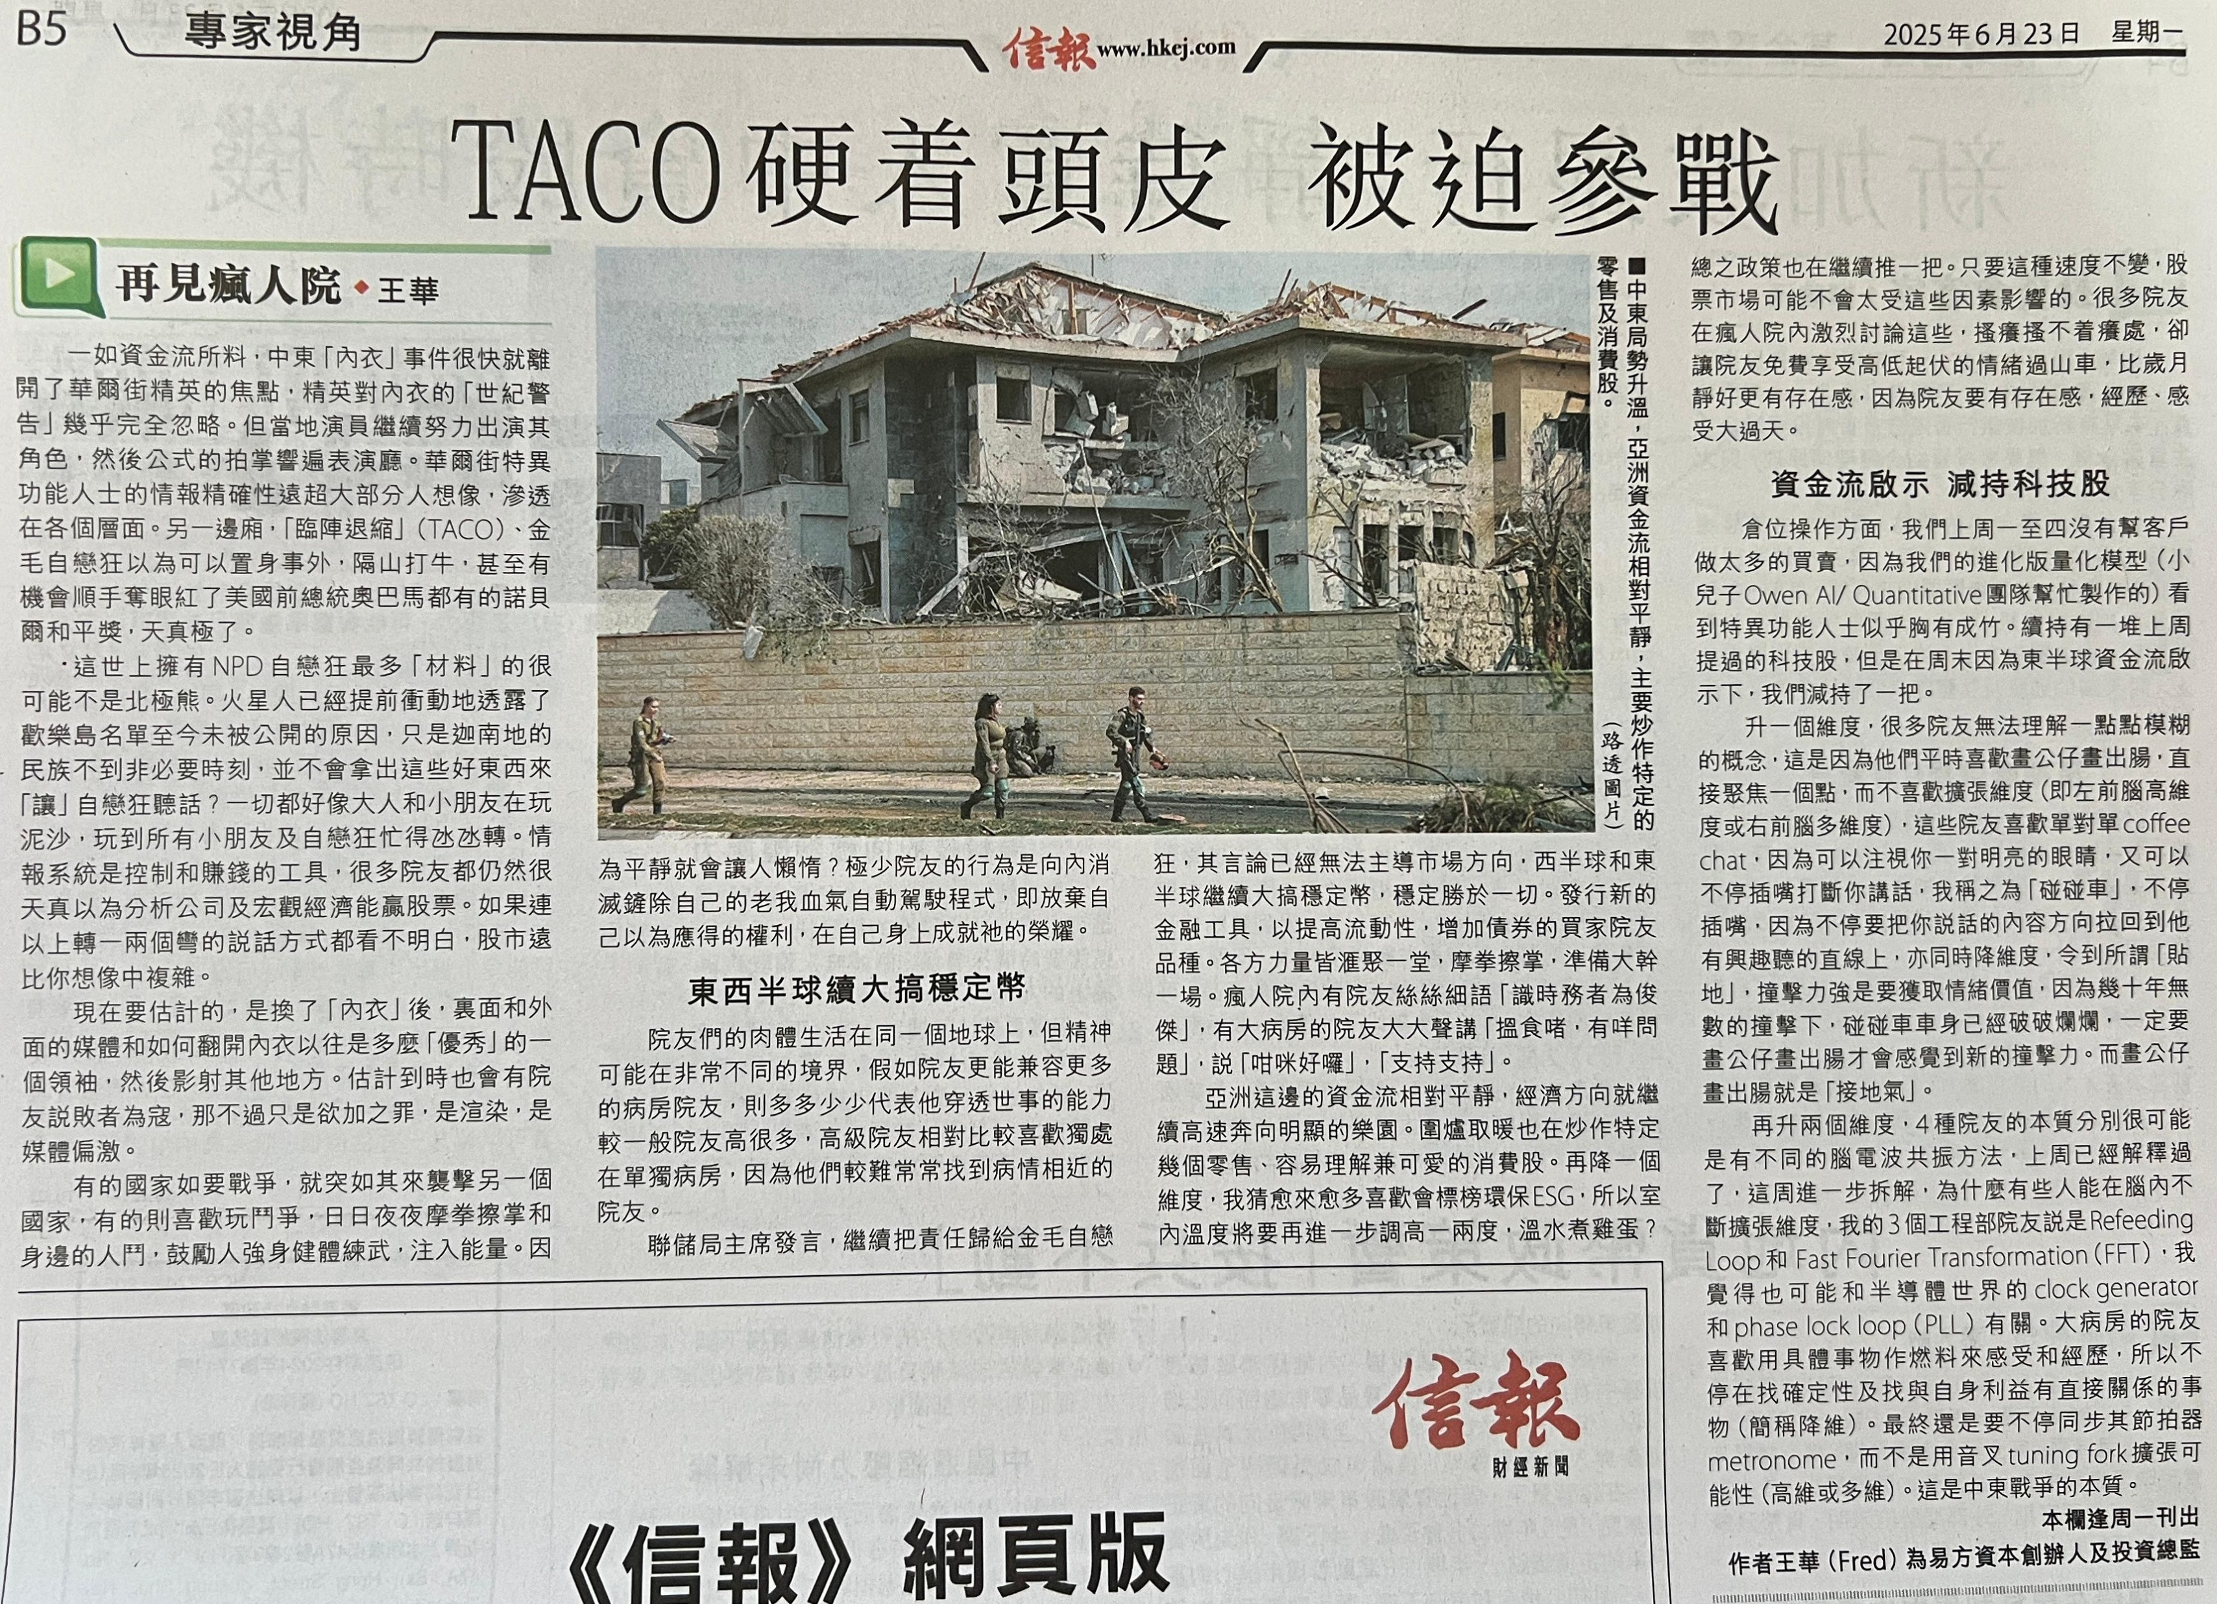

Slide 20
1 more thing…
930, 76, 828
fredfreww
Youtube, HKEJ

